Slide 1

Online Food Delivery Portal
Done by – Srinidhi Kannan (BL.EN.U4AIE21121)
Suryamritha M (BL.EN.U4AIE21126)
Varshini Balaji (BL.EN.U4AIE21139)

Slide 2
INTRODUCTION Topic: Online Food Delivery Portal Language: Java This project is an online food delivery portal where the customers can choose a restaurant of their choice and place the order. This portal is named as “SVS Food Deliveries”. This system will allow hotels and restaurants to easily deliver the food to the customers at their doorstep. We have used: Packages Inheritance Class Interface Abstract class Method Constructors Constructor overloading Scanner class Object Dynamic Method Dispatch Method overriding Conditional Loops

Slide 3
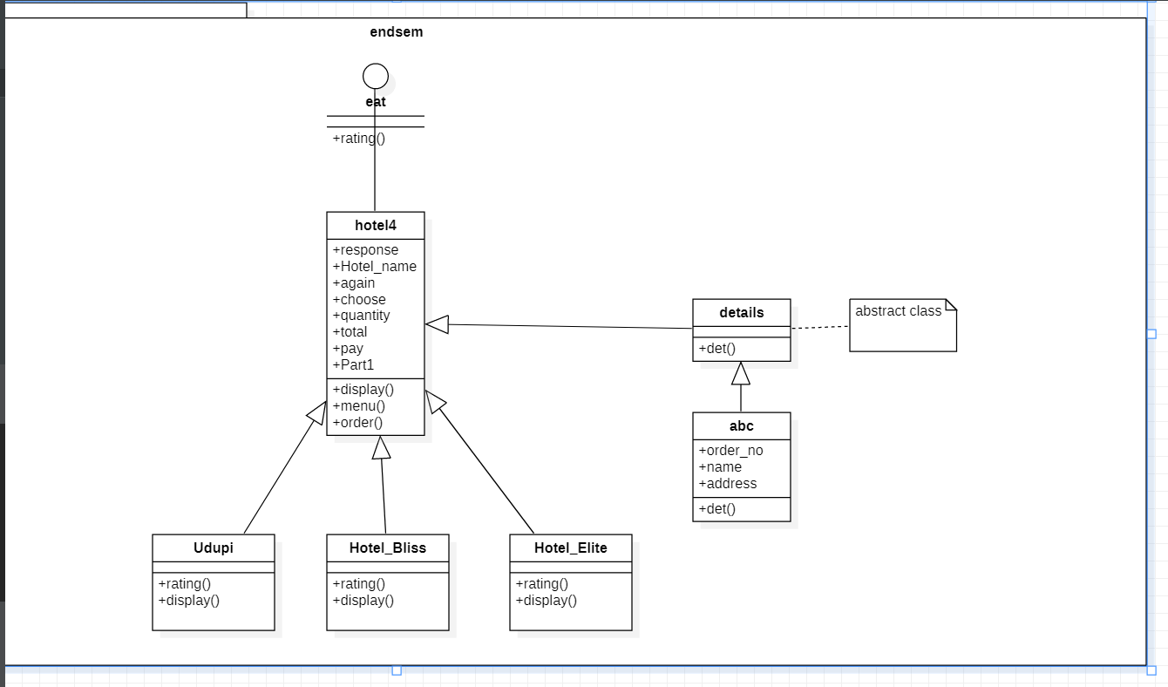
UML CLASS DIAGRAM

Slide 4
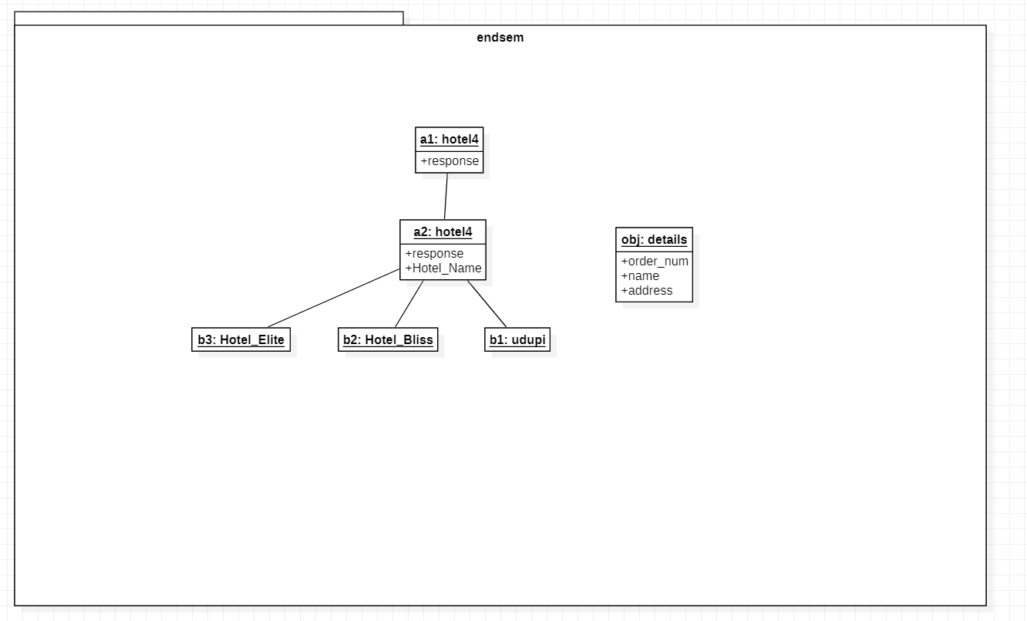
UML OBJECT DIAGRAM

Slide 5
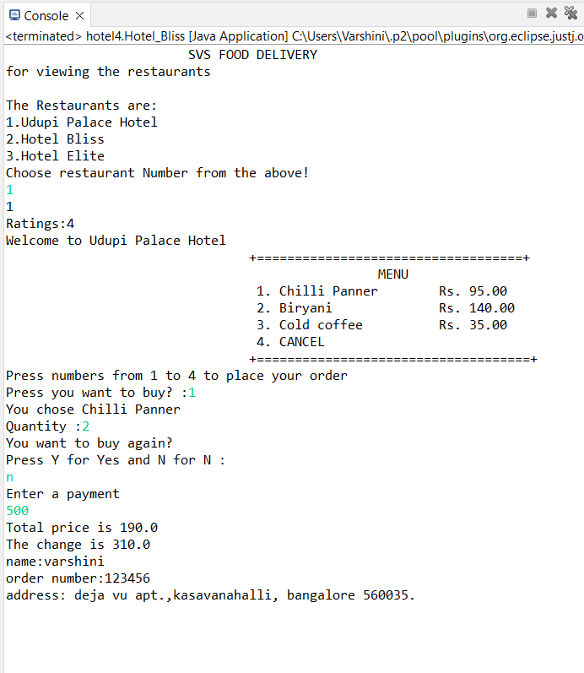
OUTPUT

